Slide 1
Car MPG dataset

Slide 2
Table of contents
Data description
Introduction
EDA
Standardization
Inference
Hypothesis testing
Data visualization

Slide 3
Table of contents
Data description
Introduction
EDA
Standardization
Inference
Hypothesis testing
Data visualization

Slide 4
1- Introduction:
The objective of this project is to use linear regression analysis on the Auto-mpg dataset to predict the fuel efficiency (Miles Per Gallon) of a vehicle based on its other characteristics.

Slide 5
2- Data description
The Auto-mpg dataset is a well-known automotive dataset available on Kaggle. It contains information about various cars from the late 1970s and early 1980s, including features such as car name, cylinders, displacement, horsepower, weight, acceleration, model year, and origin.
Auto-mpg-dataset

Slide 6
to start data cleaning, we need to identify the data type of each column‏
mpg
cylinders
displacement
horsepower
weight
acceleration
model year
origin
car name
Quantitative
Categorical

Slide 7
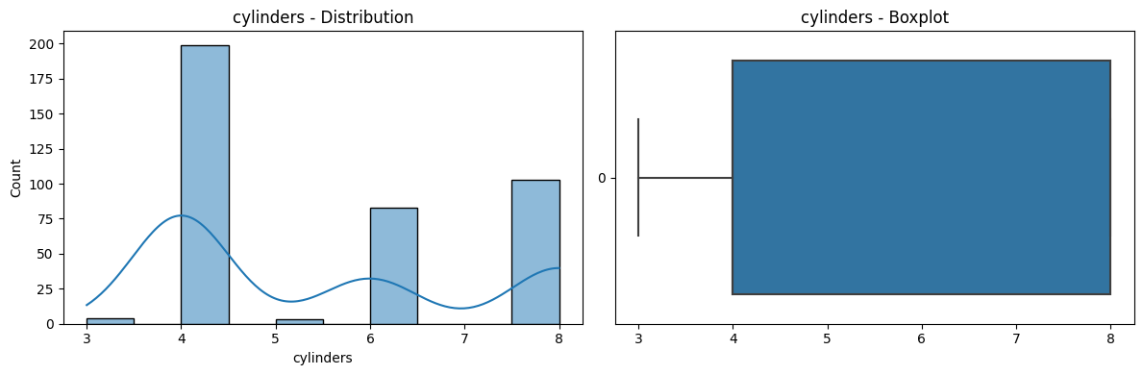
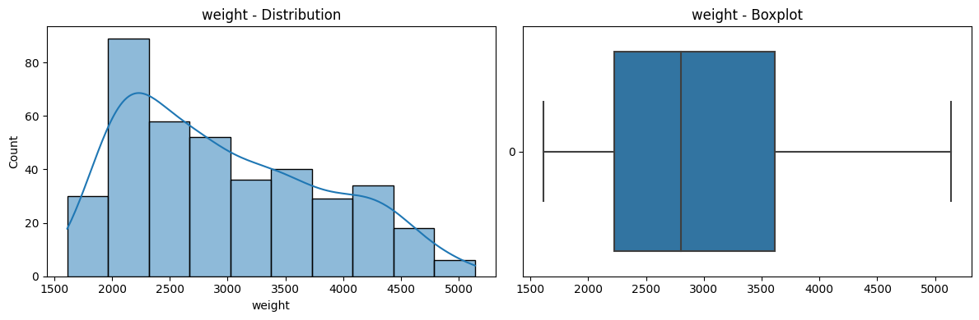
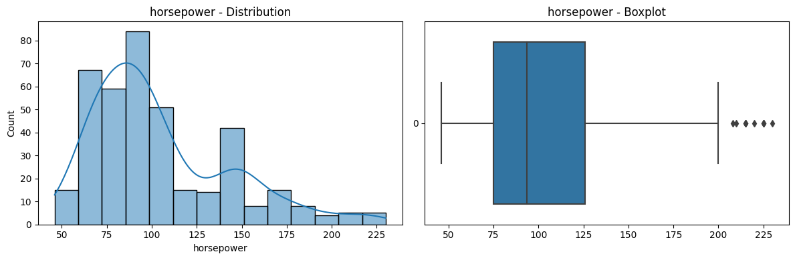
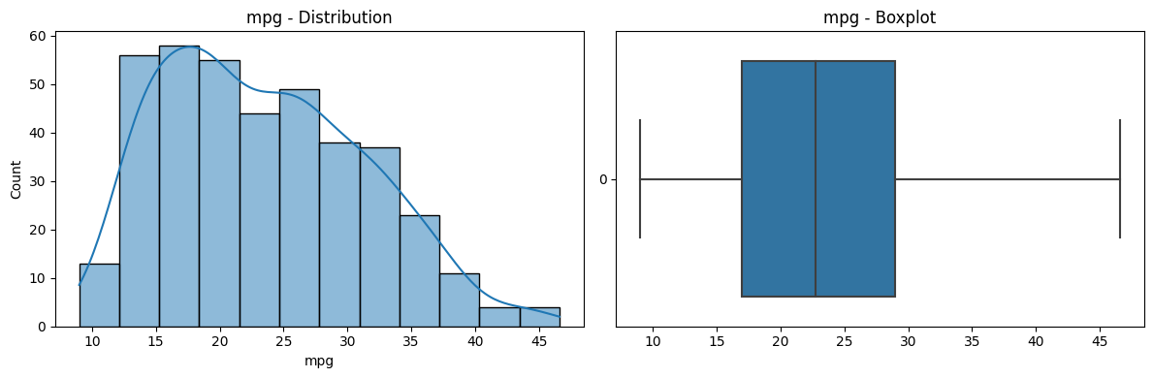
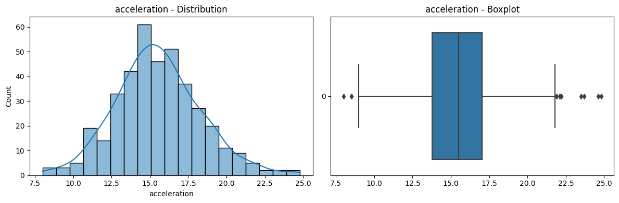
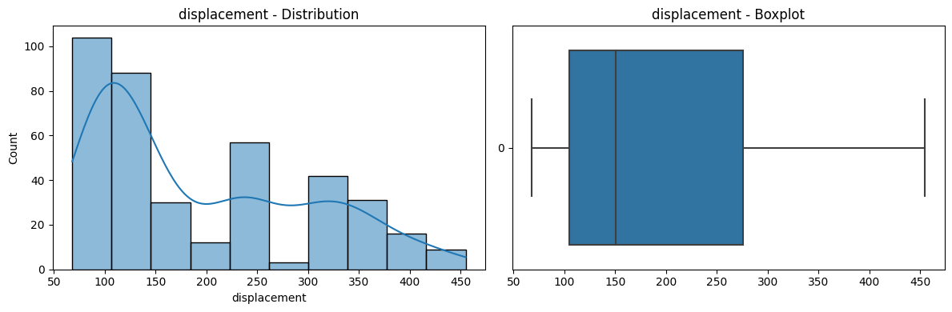
3- Data Visualization
3.1- Quantitative

Slide 8
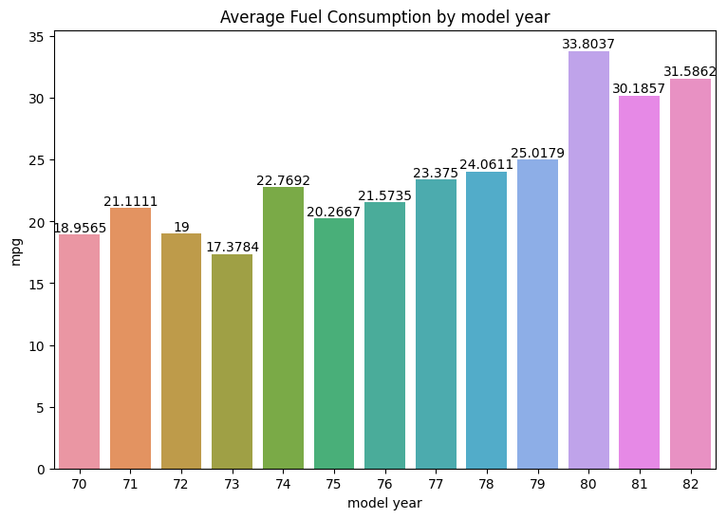
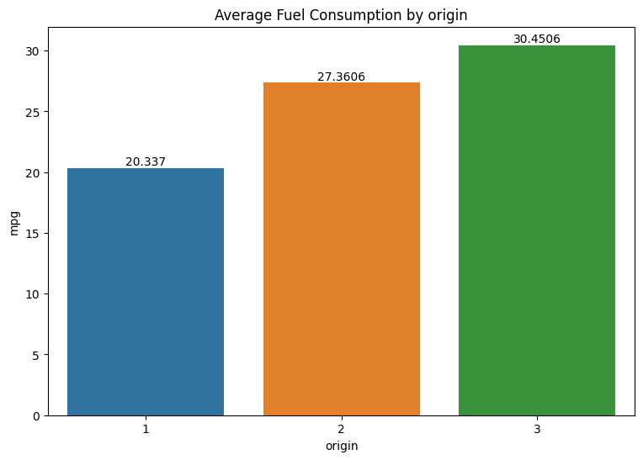
3.2- Categorical

Slide 9
4- Exploratory Data Analysis (EDA):
a. Data Cleaning
b. Descriptive statistics
Identifying null values
Assign the right data type to each column
Removing outliers
Measures of central tendency
Measure of dispersion
Measure correlation coefficients

Slide 10
Identifying Outliers
• Normal Distribution: outliers are the points that have values that fall more than three standard deviations from the mean
• Other Distribution: the outlier data points are the ones falling below Q1–1.5 IQR or above Q3 + 1.5 IQR. Q1 is the 25th percentile and Q3 is the 75th percentile of the dataset, and IQR represents the interquartile range calculated by Q3 minus Q1 (Q3–Q1),

Slide 11
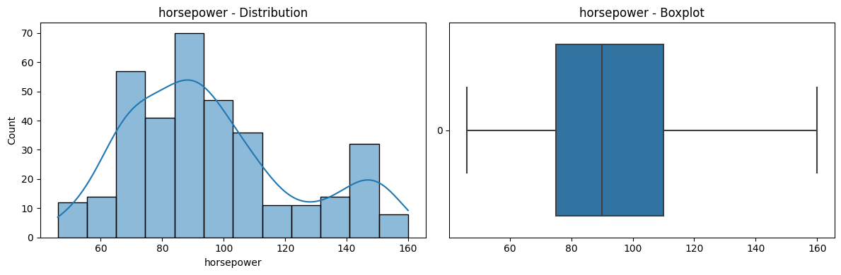
so after removing outliers, boxplot will appear as follows:

Slide 12
Descriptive statistics
Measures of central tendency
Measure of dispersion
Mean
Median
Standard deviation

Slide 13
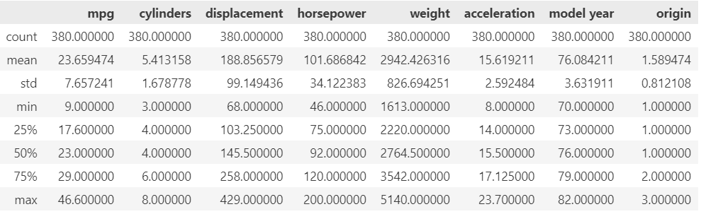
Descriptive statistics

Slide 14
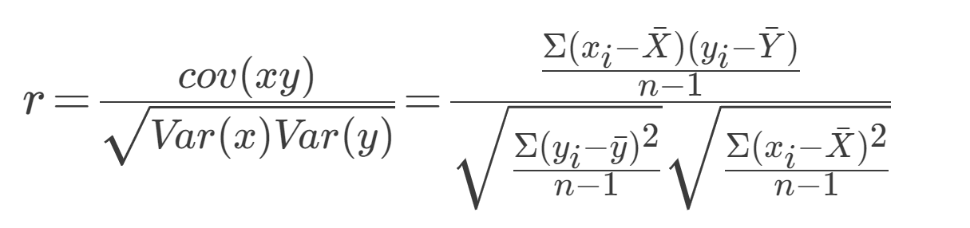
The Correlation Coefficient

Slide 15
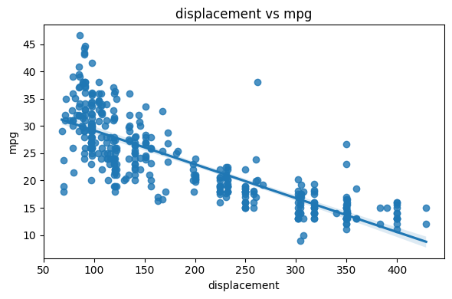
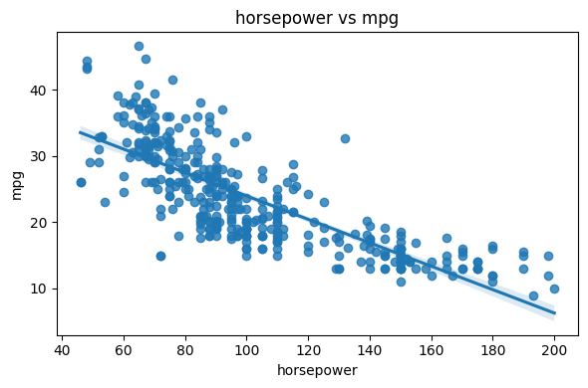
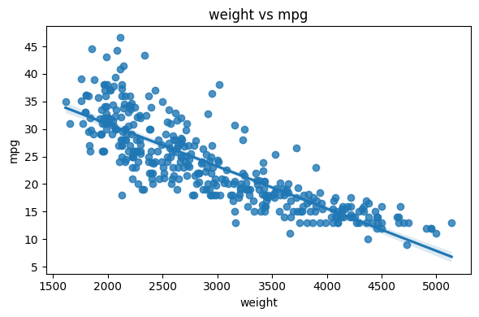
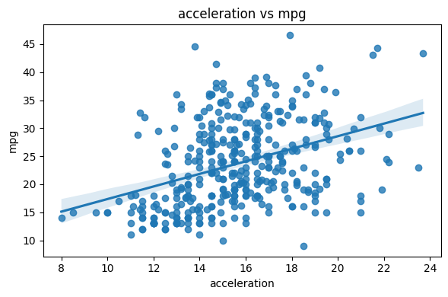

Slide 16

5- Features Standardization
range of values is different among different features, one way to solve this problem is to do features standardization.
$$Z= \frac{X− μ}{σ}$$

Slide 17
6- Hypothesis Testing
Shapiro-Wilk Test
Kolmogorov–Smirnov Test
Jarque_Bera Test
It compares the observed data with the values expected under the assumption of normality.
used to assess whether a sample data set follows a normal distribution. By comparing the calculated test statistic to a chi-square distribution.
quantifies a distance between the ECDF and CDF
Normally distributed data
Normally distributed data
Normally distributed data
Alternative assumption
Alternative assumption
Alternative assumption
Result : All features are NOT normally distributed except for acceleration.
Result : All features are NOT normally distributed except for acceleration.
Result : All features are NOT normally distributed except for acceleration.

Slide 18
Put on your seat belts and get ready!!!
the data is ready for prediction.

Slide 19
Put on your seat belts and get ready!!!
the data is ready for prediction.

Slide 20
7. Inference

Slide 21
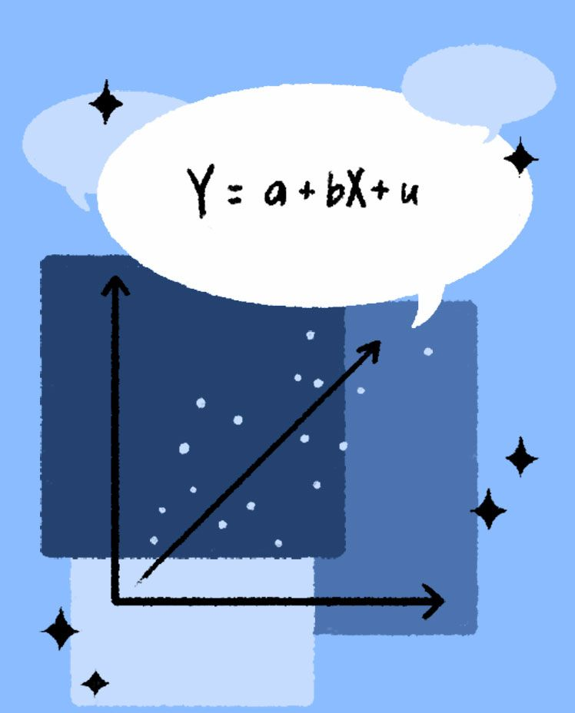
Linear regression

Slide 22
MEANING
Linear regression is a statistical technique used to model the relationship between a dependent variable (in this case, "mpg") and independent variables. By analyzing this relationship in the Auto-mpg dataset, we can understand the factors that impact fuel efficiency and make informed decisions for vehicle design and optimization.

Slide 23
Ŷ=m*X + b

Slide 24
The Equation parameters
Ŷ
m
b
Dependent variable
Coefficients for the independent variables
Y-intercept

Slide 25


Methods

Slide 26
linear regression coefficients response against each predictor individually
from scratch
using python package
Multivariable Linear Regression

Slide 27
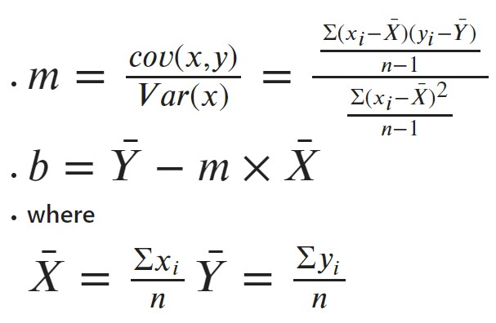
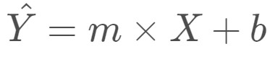
Linear regression
A Linear regressions coefficients (m, b) are calculated for each predictor individually.
m and b are calculated from scratch by the following equations:
To calculate the mean and the intercept

Slide 28

Linear regression by Python package

Slide 29
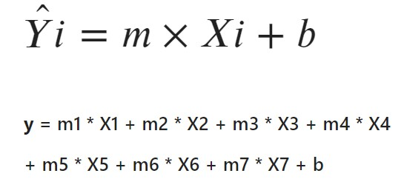
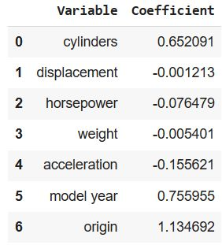
Multivariable Linear Regression
y: is the dependent variable.
X1 - X7: the independent variable.
m1 - m7: are the regression coefficients.
b: is the intercept

Slide 30
THANKS
Mahmoud Mohamed Ali
Omar Mohamed Ahmed
Omar Abd Elnasser
Amgad Atef Shaban
Please keep this slide for attribution.

